Slide 1
More E/R, UML, ODL Database Design Using the E-R Model -2

Slide 2
Outline
Extended E-R Features
Entity-Relationship Design Issues
Alternative Notations for Modeling Data
Other Aspects of Database Design

Slide 3
Extended E-R Features

Slide 4
Specialization
Top-down design process; we designate sub-groupings within an entity set that are distinctive from other entities in the set.
These sub-groupings become lower-level entity sets that have attributes or participate in relationships that do not apply to the higher-level entity set.
Depicted by a triangle component labeled ISA (e.g., instructor “is a” person).
Attribute inheritance – a lower-level entity set inherits all the attributes and relationship participation of the higher-level entity set to which it is linked.
Notes:
An entity set may include subgroupings of entities that are distinct in some way from other entities in the set. For instance, a subset of entities within an entity set may have attributes that are not shared by all the entities in the entity set. The E-R model provides a means for representing these distinctive entity groupings.
A crucial property of the higher- and lower-level entities created by specialization and generalization is attribute inheritance. The attributes of the higher-level entity sets are said to be inherited by the lower-level entity sets. For example, student and employee inherit the attributes of person
The process of designating subgroupings within an entity set is called specialization. The specialization of person allows us to distinguish among person entities according to whether they correspond to employees or students: in general, a person could be an employee, a student, both, or neither
In terms of an E-R diagram, specialization is depicted by a hollow arrow-head pointing from the specialized entity to the other entity (see Figure 6.18). We refer to this relationship as the ISA relationship, which stands for “is a” and represents, for example, that an instructor “is a” employee.
Slajd--

Slide 5
Specialization Example
Overlapping – employee and student
Disjoint – instructor and secretary
Total and partial
Notes:
In terms of an E-R diagram, specialization is depicted by a hollow arrow-head pointing from the specialized entity to the other entity (see Figure 6.18). We refer to this relationship as the ISA relationship, which stands for “is a” and represents, for example, that an instructor “is a” employee.
The way we depict specialization in an E-R diagram depends on whether an entity may belong to multiple specialized entity sets or if it must belong to at most one specialized entity set. The former case (multiple sets permitted) is called overlapping specialization, while the latter case (at most one permitted) is called disjoint specialization. For an overlapping specialization (as is the case for student and employee as specializations of person), two separate arrows are used. For a disjoint specialization (as is the case for instructor and secretary as specializations of employee), a single arrow is used. The specialization relationship may also be referred to as a superclass-subclass relationship. Higher- and lower-level entity sets are depicted as regular entity sets—that is, as rectangles containing the name of the entity set.

Slide 6
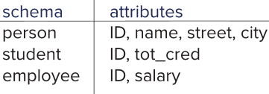
Representing Specialization via Schemas
Method 1:
Form a schema for the higher-level entity
Form a schema for each lower-level entity set, include primary key of higher-level entity set and local attributes
Drawback: getting information about, an employee requires accessing two relations, the one corresponding to the low-level schema and the one corresponding to the high-level schema
Notes:
6

Slide 7
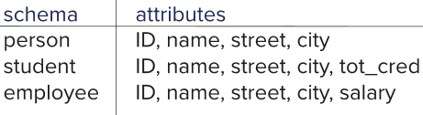
Representing Specialization as Schemas (Cont.)
Method 2:
Form a schema for each entity set with all local and inherited attributes
Drawback: name, street and city may be stored redundantly for people who are both students and employees
Notes:
7

Slide 8
Generalization
A bottom-up design process – combine a number of entity sets that share the same features into a higher-level entity set.
Specialization and generalization are simple inversions of each other; they are represented in an E-R diagram in the same way.
The terms specialization and generalization are used interchangeably.
Notes:
The refinement from an initial entity set into successive levels of entity subgroupings represents a top-down design process in which distinctions are made explicit. The design process may also proceed in a bottom-up manner, in which multiple entity sets are synthesized into a higher-level entity set on the basis of common features.
Specialization and generalization are simple inversions of each other; they are represented in an E-R diagram in the same way.
The terms specialization and generalization are used interchangeably
slajd

Slide 9
Completeness constraint
Completeness constraint -- specifies whether or not an entity in the higher-level entity set must belong to at least one of the lower-level entity sets within a generalization.
total: an entity must belong to one of the lower-level entity sets
partial: an entity need not belong to one of the lower-level entity sets
Notes:
One type of constraint on specialization which we saw earlier specifies whether a specialization is disjoint or overlapping. Another type of constraint on a specialization/generalization is a completeness constraint, which specifies whether or not an entity in the higher-level entity set must belong to at least one of the lower-level entity sets within the generalization/specialization.
This constraint may be one of the following:
• Total specialization or generalization. Each higher-level entity must belong to a lower-level entity set.
• Partial specialization or generalization. Some higher-level entities may not belong to any lower-level entity set.

Slide 10
Completeness constraint (Cont.)
Partial generalization is the default.
We can specify total generalization in an ER diagram by adding the keyword total in the diagram and drawing a dashed line from the keyword to the corresponding hollow arrow-head to which it applies (for a total generalization), or to the set of hollow arrow-heads to which it applies (for an overlapping generalization).
The student generalization is total: All student entities must be either graduate or undergraduate. Because the higher-level entity set arrived at through generalization is generally composed of only those entities in the lower-level entity sets, the completeness constraint for a generalized higher-level entity set is usually total
Notes:
Partial specialization is the default.
We can specify total specialization in an E-R diagram by adding the keyword “total” in the diagram and drawing a dashed line from the keyword to the corresponding hollow arrowhead to which it applies (for a total specialization), or to the set of hollow arrowheads to which it applies (for an overlapping specialization).
Example
The student generalization is total: All student entities must be either graduate or undergraduate. Because the higher-level entity set arrived at through generalization is generally composed of only those entities in the lower-level entity sets, the completeness constraint for a generalized higher-level entity set is usually total

Slide 11
Aggregation
Consider the ternary relationship proj_guide, which we saw earlier
Suppose we want to record evaluations of a student by a guide on a project
Notes:
One limitation of the E-R model is that it cannot express relationships among relationships. To illustrate the need for such a construct, consider the ternary relationship proj_guide, which we saw earlier, between an instructor, student and project (see Figure 6.6).
Now suppose that each instructor guiding a student on a project is required to file a monthly evaluation report.
We model the evaluation report as an entity evaluation, with a primary key evaluation_id. One alternative for recording the (student, project, instructor) combination to which an evaluation corresponds is to create a quaternary (4-way) relationship set eval_for between instructor, student, project, and evaluation.
(A quaternary relationship is required—a binary relationship between student and evaluation, for example, would not permit us to represent the (project, instructor) combination to which an evaluation corresponds.) Using the basic E-R modeling constructs, we obtain the E-R diagram of Figure 6.19. (We have omitted the attributes of the entity sets, for simplicity.)

Slide 12
Aggregation (Cont.)
Relationship sets eval_for and proj_guide represent overlapping information
Every eval_for relationship corresponds to a proj_guide relationship
However, some proj_guide relationships may not correspond to any eval_for relationships
So we can’t discard the proj_guide relationship
Eliminate this redundancy via aggregation
Treat relationship as an abstract entity
Allows relationships between relationships
Abstraction of relationship into new entity
Notes:
We model the evaluation report as an entity evaluation, with a primary key evaluation_id. One alternative for recording the (student, project, instructor) combination to which an evaluation corresponds is to create a quaternary (4-way) relationship set_eval_for between instructor, student, project, and evaluation. (A quaternary relationship is required—a binary relationship between student and evaluation, for example, would not permit us to represent the (project, instructor) combination to which an evaluation corresponds.) Using the basic E-R modeling constructs, we obtain the E-R diagram of Figure 6.19. (We have omitted the attributes of the entity sets, for simplicity.)
It appears that the relationship sets proj_guide and eval_for can be combined into one single relationship set. Nevertheless, we should not combine them into a single relationship, since some instructor, student, project combinations may not have an associated evaluation.
Pa slajd

Slide 13
Aggregation (Cont.)
Eliminate this redundancy via aggregation without introducing redundancy, the following diagram represents:
A student is guided by a particular instructor on a particular project
A student, instructor, project combination may have an associated evaluation
Notes:
13
The best way to model a situation such as the one just described is to use aggregation. Aggregation is an abstraction through which relationships are treated as higher level entities. Thus, for our example, we regard the relationship set proj_guide (relating the entity sets instructor, student, and project) as a higher-level entity set called proj_guide. Such an entity set is treated in the same manner as is any other entity set. We can then create a binary relationship eval_for between proj__guide and evaluation to represent which (student, project, instructor) combination an evaluation is for. Figure 6.20 shows a notation for aggregation commonly used to represent this situation.

Slide 14
Reduction to Relational Schemas
To represent aggregation, create a schema containing
Primary key of the aggregated relationship,
The primary key of the associated entity set
Any descriptive attributes
In our example:
The schema eval_for is:
eval_for (s_ID, project_id, i_ID, evaluation_id)
The schema proj_guide is redundant.
Notes:
Designing schemas for an E-R diagram containing aggregation is straightforward. Consider Figure 6.20. The schema for the relationship set eval_for between the aggregation of proj_guide and the entity set evaluation includes an attribute for each attribute in the primary keys of the entity set evaluation and the relationship set proj_guide. It also includes an attribute for any descriptive attributes, if they exist, of the relationship set eval_for. We then transform the relationship sets and entity sets within the aggregated entity set following the rules we have already defined.

Slide 15
Design Issues

Slide 16
Common Mistakes in E-R Diagrams
Example of erroneous E-R diagrams
Notes:
16
The notions of an entity set and a relationship set are not precise, and it is possible to define a set of entities and the relationships among them in a number of different ways. In this section, we examine basic issues in the design of an E-R database schema. Section 6.11 covers the design process in further detail.
A common mistake when creating E-R models is the use of the primary key of an entity set as an attribute of another entity set, instead of using a relationship. For example, in our university E-R model, it is incorrect to have dept_name as an attribute of student, as depicted in Figure 6.21a, even though it is present as an attribute in the relation schema for student. The relationship stud_dept is the correct way to represent this information in the E-R model, since it makes the relationship between student and department explicit, rather than implicit via an attribute. Having an attribute dept_name as well as a relationship stud_dept would result in duplication of information.
Another related mistake that people sometimes make is to designate the primary key attributes of the related entity sets as attributes of the relationship set. For example, ID (the primary-key attributes of student) and ID (the primary key of instructor) should not appear as attributes of the relationship advisor. This should not be done since the primary-key attributes are already implicit in the relationship set.
A third common mistake is to use a relationship with a single-valued attribute in a situation that requires a multivalued attribute. For example, suppose we decided to represent the marks that a student gets in different assignments of a course offering (section). A wrong way of doing this would be to add two attributes assignment and marks to the relationship takes, as depicted in Figure 6.21b. The problem with this design is that we can only represent a single assignment for a given student-section pair, since relationship instances must be uniquely identified by the participating entities, student and section

Slide 17
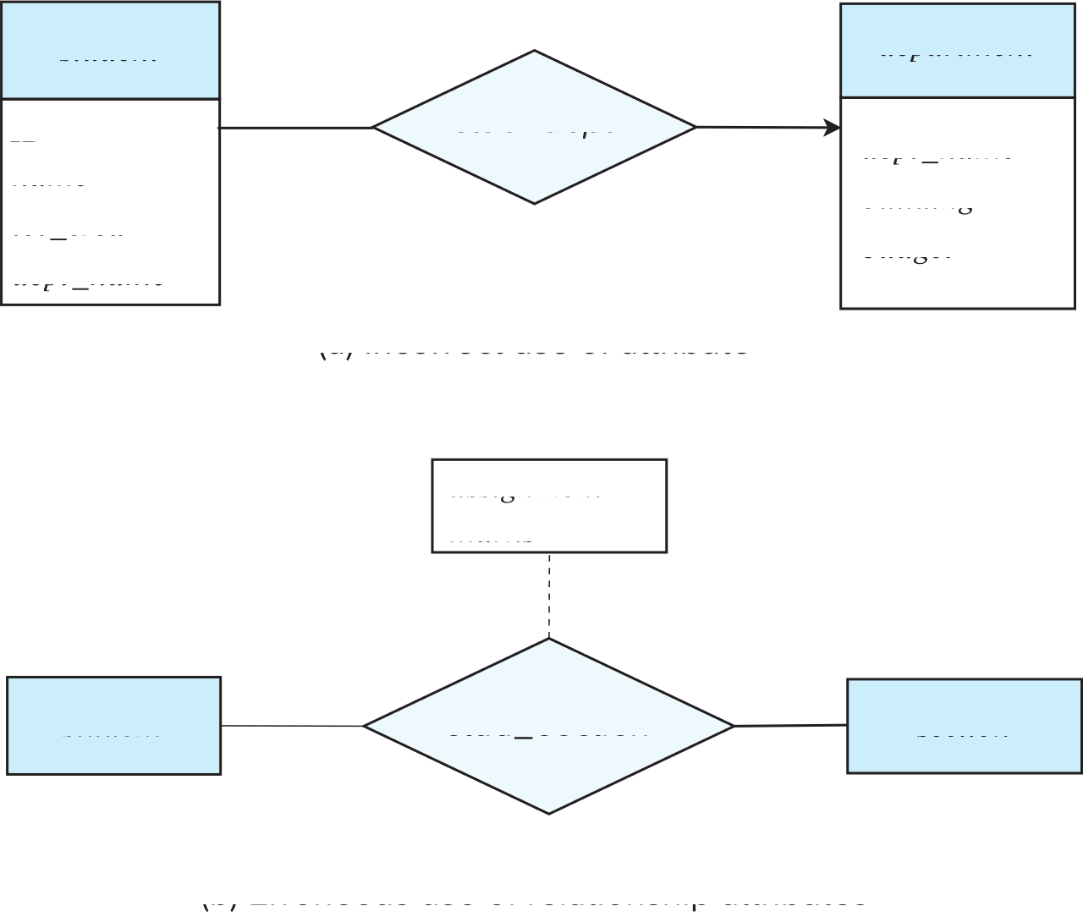
Common Mistakes in E-R Diagrams (Cont.)
Notes:
17
One solution to the problem depicted in Figure 6.21c, shown in Figure 6.22a, is to model assignment as a weak entity identified by section, and to add a relationship marks_in between assignment and student; the relationship would have an attribute marks. An alternative solution, shown in Figure 6.22d, is to use a multivalued composite attribute {assignment marks} to takes, where assignment marks has component attributes assignment and marks. Modeling an assignment as a weak entity is preferable in this case, since it allows recording other information about the assignment, such as maximum marks or deadlines
When an E-R diagram becomes too big to draw in a single piece, it makes sense to break it up into pieces, each showing part of the E-R model. When doing so, you may need to depict an entity set in more than one page. As discussed in Section 6.2.2, attributes of the entity set should be shown only once, in its first occurrence. Subsequent occurrences of the entity set should be shown without any attributes, to avoid repeating the same information at multiple places, which may lead to inconsistency

Slide 18
Entities vs. Attributes
Use of entity sets vs. attributes
Use of phone as an entity allows extra information about phone numbers (plus multiple phone numbers)
Notes:
18
Consider the entity set instructor with the additional attribute phone number (Figure 6.23a.) It can be argued that a phone is an entity in its own right with attributes phone_number and location; the location may be the office or home where the phone is located, with mobile (cell) phones perhaps represented by the value “mobile.” If we take this point of view, we do not add the attribute phone number to the instructor. Rather, we create:
• A phone entity set with attributes phone number and location.
• A relationship set inst_phone, denoting the association between instructors and the phones that they have.
This alternative is shown in Figure 6.23b.- desna slika

Slide 19
Entities vs. Relationship sets
Use of entity sets vs. relationship sets
Possible guideline is to designate a relationship set to describe
an action that occurs between entities
Placement of relationship attributes
For example, attribute date as attribute of advisor or as attribute of student
Notes:
19
It is not always clear whether an object is best expressed by an entity set or a relationship set. In Figure 6.15, we used the takes relationship set to model the situation where a student takes a (section of a) course. An alternative is to imagine that there is a course registration record for each course that each student takes. Then, we have an entity set to represent the course-registration record. Let us call that entity set registration. Each registration entity is related to exactly one student and to exactly one section, so we have two relationship sets, one to relate course-registration records to students and one to relate course-registration records to sections. In Figure 6.24, we show the entity sets section and student from Figure 6.15 with the takes relationship set replaced by one entity set and two relationship sets:
registration, the entity set representing course-registration records.
Section_reg, the relationship set relating registration and course.
Student_reg, the relationship set relating registration and student.

Slide 20
Binary Vs. Non-Binary Relationships
Although it is possible to replace any non-binary (n-ary, for n > 2) relationship set by a number of distinct binary relationship sets, a n-ary relationship set shows more clearly that several entities participate in a single relationship.
Some relationships that appear to be non-binary may be better represented using binary relationships
For example, a ternary relationship parents, relating a child to his/her father and mother, is best replaced by two binary relationships, father and mother
Using two binary relationships allows partial information (e.g., only mother being known)
But there are some relationships that are naturally non-binary
Example: proj_guide
Notes:
20
Relationships in databases are often binary. Some relationships that appear to be non-binary could actually be better represented by several binary relationships. For instance, one could create a ternary relationship parent, relating a child to his/her mother and father. However, such a relationship could also be represented by two binary relationships, mother and father, relating a child to his/her mother and father separately. Using the two relationships mother and father provides us with a record of a child’s mother, even if we are not aware of the father’s identity; a null value would be required if the ternary relationship parent were used. Using binary relationship sets is preferable in this case.

Slide 21
Converting Non-Binary Relationships to Binary Form
In general, any non-binary relationship can be represented using binary relationships by creating an artificial entity set.
Replace R between entity sets A, B and C by an entity set E, and three relationship sets:
1. R_{A}, relating E and A 2. R_{B}, relating E and B 3. R_{C}, relating E and C
Create an identifying attribute for E and add any attributes of R to E
For each relationship (a_{i} , b_{i} , c_{i}) in R, create
1. a new entity e_{i} in the entity set E 2. add (e_{i} , a_{i} ) to R_{A}
3. add (e_{i} , b_{i} ) to R_{B} 4. add (e_{i} , c_{i} ) to R_{C}
Notes:
21
In fact, it is always possible to replace a nonbinary (n-ary, for n > 2) relationship set by a number of distinct binary relationship sets. For simplicity, consider the abstract ternary (n = 3) relationship set R, relating entity sets A, B, and C. We replace the relationship set R with an entity set E, and we create three relationship sets as shown in Figure 6.25:
• RA, a many-to-one relationship set from E to A.
• RB, a many-to-one relationship set from E to B.
• RC, a many-to-one relationship set from E to C.
E is required to have total participation in each of RA, RB, and RC. If the relationship set R had any attributes, these are assigned to entity set E; further, a special identifying attribute is created for E (since it must be possible to distinguish different entities in an entity set on the basis of their attribute values). For each relationship (ai , bi ,ci ) in the relationship set R, we create a new entity ei in the entity set E. Then, in each of the three new relationship sets, we insert a relationship as follows:
• (ei , ai ) in RA.
• (ei , bi ) in RB.
• (ei ,ci ) in RC.

Slide 22
Converting Non-Binary Relationships (Cont.)
Also need to translate constraints
Translating all constraints may not be possible
There may be instances in the translated schema that cannot correspond to any instance of R
Exercise: add constraints to the relationships R_{A}, R_{B} and R_{C} to ensure that a newly created entity corresponds to exactly one entity in each of entity sets A, B and C
We can avoid creating an identifying attribute by making E a weak entity set (described shortly) identified by the three relationship sets
Notes:
22
We can generalize this process in a straightforward manner to n-ary relationship sets. Thus, conceptually, we can restrict the E-R model to include only binary relationship sets. However, this restriction is not always desirable.
• An identifying attribute may have to be created for the entity set created to represent the relationship set. This attribute, along with the extra relationship sets required, increases the complexity of the design and (as we shall see in Section 6.7) overall storage requirements.
• An n-ary relationship set shows more clearly that several entities participate in a single relationship.
• There may not be a way to translate constraints on the ternary relationship into constraints on the binary relationships. For example, consider a constraint that says that R is many-to-one from A, B to C; that is, each pair of entities from A and B is associated with at most one C entity. This constraint cannot be expressed by using cardinality constraints on the relationship sets RA, RB, and RC.

Slide 23
E-R Design Decisions
The use of an attribute or entity set to represent an object.
Whether a real-world concept is best expressed by an entity set or a relationship set.
The use of a ternary relationship versus a pair of binary relationships.
The use of a strong or weak entity set.
The use of specialization/generalization – contributes to modularity in the design.
The use of aggregation – can treat the aggregate entity set as a single unit without concern for the details of its internal structure.
Notes:
Нема
A diagrammatic representation of the data model of an application is a very important part of designing a database schema. Creation of a database schema requires not only data modeling experts, but also domain experts who know the requirements of the application but may not be familiar with data modeling. An intuitive diagrammatic representation is particularly important since it eases communication of information between these groups of experts. A number of alternative notations for modeling data have been proposed, of which E-R diagrams and UML class diagrams are the most widely used. There is no universal standard for E-R diagram notation, and different books and E-R diagram software use different notations. In the rest of this section, we study some of the alternative E-R diagram notations, as well as the UML class diagram notation. To aid in comparison of our notation with these alternatives, Figure 6.26 summarizes the set of symbols we have used in our E-R diagram notation.

Slide 24
UML
UML: Unified Modeling Language
UML has many components to graphically model different aspects of an entire software system
UML Class Diagrams correspond to E-R Diagram, but several differences.
Notes:
Entity-relationship diagrams help model the data representation component of a software system. Data representation, however, forms only one part of an overall system design. Other components include models of user interactions with the system, specification of functional modules of the system and their interaction, etc. The Unified Modeling Language (UML) is a standard developed under the auspices of the Object Management Group (OMG) for creating specifications of various components of a software system. Some of the parts of UML are:
• Class diagram. A class diagram is similar to an E-R diagram. Later in this section we illustrate a few features of class diagrams and how they relate to E-R diagrams.
• Use case diagram. Use case diagrams show the interaction between users and the system, in particular the steps of tasks that users perform (such as withdrawing money or registering for a course).
• Activity diagram. Activity diagrams depict the flow of tasks between various components of a system.
• Implementation diagram. Implementation diagrams show the system components and their interconnections, both at the software component level and the hardware component level.

Slide 25
UML Class Diagrams (Cont.)
Binary relationship sets are represented in UML by just drawing a line connecting the entity sets. The relationship set name is written adjacent to the line.
The role played by an entity set in a relationship set may also be specified by writing the role name on the line, adjacent to the entity set.
The relationship set name may alternatively be written in a box, along with attributes of the relationship set, and the box is connected, using a dotted line, to the line depicting the relationship set.
Notes:
Slajd
Single values such as 1 or ∗ may be written on edges; the single value 1 on an edge is treated as equivalent to 1..1, while ∗ is equivalent to 0.. ∗. UML supports generalization; the notation is basically the same as in our E-R notation, including the representation of disjoint and overlapping generalizations.
UML class diagrams include several other notations that approximately correspond to the E-R notations we have seen. A line between two entity sets with a small shaded diamond at one end in UML specifies “composition” in UML. The composition relationship between E2 and E1 in Figure 6.28 indicates that E2 is existence dependent on E1; this is roughly equivalent to denoting E2 as a weak entity set that is existence dependent on the identifying entity set E1. (The term aggregation in UML denotes a variant of composition where E2 is contained in E1 but may exist independently, and it is denoted using a small hollow diamond.)

Slide 26
Other Aspects of Database Design
Functional Requirements
Data Flow, Workflow
Schema Evolution
Notes:
Functional Requirements All enterprises have rules on what kinds of functionality are to be supported by an enterprise application. These could include transactions that update the data, as well as queries to view data in a desired fashion. In addition to planning the functionality, designers have to plan the interfaces to be built to support the functionality.
Data Flow, Workflow The term workflow refers to the combination of data and tasks involved in processes like those of the preceding examples. Workflows interact with the database system as they move among users and users perform their tasks on the workflow. In addition to the data on which workflows operate, the database may store data about the workflow itself, including the tasks making up a workflow and how they are to be routed among users. Workflows thus specify a series of queries and updates to the database that may be taken into account as part of the database-design process.
Schema Evolution Database design is usually not a one-time activity. The needs of an organization evolve continually, and the data that it needs to store also evolve correspondingly. During the initial database-design phases, or during the development of an application, the database designer may realize that changes are required at the conceptual, logical, or physical schema levels. Changes in the schema can affect all aspects of the database application. A good database design anticipates future needs of an organization and ensures that the schema requires minimal changes as the needs evolve.

Slide 27
End

